Slide 1

Sentence Predictor using NLP and Neural Networks
Discover the power of natural language processing combined with neural networks to predict sentences. Explore the LSTM model in this exciting project.

Slide 2

Natural Language Processing
What is NLP?
Why is it important?
Examples of NLP
NLP is a subfield of linguistics, computer science, and AI that focuses on the interaction between computers and human languages.
NLP techniques allow computers to analyze, understand and generate human language. This has important applications in areas such as speech recognition, sentiment analysis and machine translation.
Some examples of NLP include text classification, information extraction, text summarization and Sentence prediction.

Slide 3
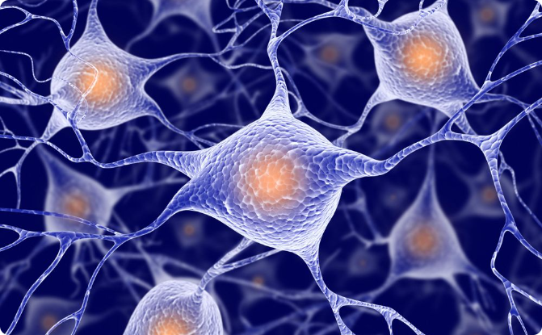
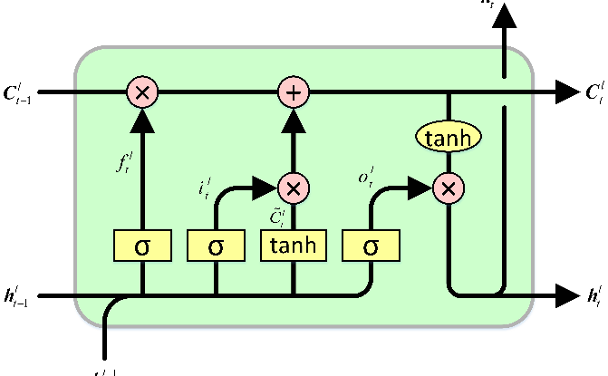
Neural Networks
What are neural networks?
LSTM
A neural network is a type of machine learning algorithm modeled after the structure of the human brain. It consists of interconnected nodes, or "neurons," that process and transmit information.
Long Short-Term Memory is a type of recurrent neural network architecture that allows the network to remember information over long periods of time, making it ideal for natural language processing tasks such as sentence prediction.

Slide 4
Project Details
1
Description
The Sentence Predictor project uses LSTM model to predict sentences based on a given input. The model is trained on a book corpus of text data to learn the patterns and structures of language.
2
Training
The model is trained on 100 epochs using a combination of backpropagation and gradient descent algorithms to optimize the weights of the network. We have also used the softmax activation function to produce probability distributions over the possible output classes.
3
Accuracy and Loss
During training, the accuracy and loss of the model are tracked over each epoch and visualized to help understand how the model is performing and to identify overfitting or other issues.

Slide 5
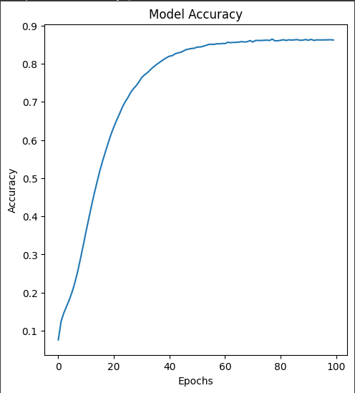
Model Accuracy
The accuracy of the model starts at 9% when trained for 0 epochs and gradually increases to approximately 85% when trained on 100 epochs. This improvement in accuracy reflects the model's ability to learn and make more accurate predictions over time.

Slide 6
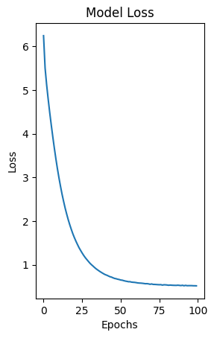
Model Loss
The loss of the model starts at almost more than 60% when trained at 0 epochs and gradually decreases to approximately 4% when trained at a full 100 epochs. This decrease in loss indicates that the model is getting better at minimizing errors and making more accurate predictions as the training progresses.

Slide 7

Application
Prediction
Future Developments
The Sentence Predictor can be used to generate sentences based on a given input. This has applications in areas such as chatbots, language translation, and text generation.
In order to improve the Sentence Predictor, we can explore the use of multimodal input, incorporating additional sources of information such as images or audio. Additionally, we can fine-tune the model by adjusting its parameters and architecture to further optimize its performance. Finally, training the model on a much larger dataset or data can also lead to improved results and better generalization.

Slide 8
Conclusion
Key Takeaways
The Sentence Predictor project demonstrates the power of combining natural language processing techniques with neural networks. It has applications in a wide range of fields and has the potential to revolutionize the way we interact with computers.
Inspiration
The Sentence Predictor project is just one example of the exciting possibilities that arise from combining different areas of expertise and finding innovative solutions to complex problems.
References
Article 1: https://ieeexplore.ieee.org/abstract/document/8971796
Article 2:https://www.researchgate.net/publication/366797183_Next_Word_Prediction_with_Deep_Learning_Models

